Slide 1

Dynamic Adjusting Prosthetic Socket
Joshua Friscia (RBE/ME), Meagan Hiatt (RBE/ECE), Mollie Myers (BME), Jacob Zizmor (RBE)
Advisors: Gregory Fischer, Cagdas Onal
Co-Advisors: Michael Delph, Christopher Nycz

Slide 2
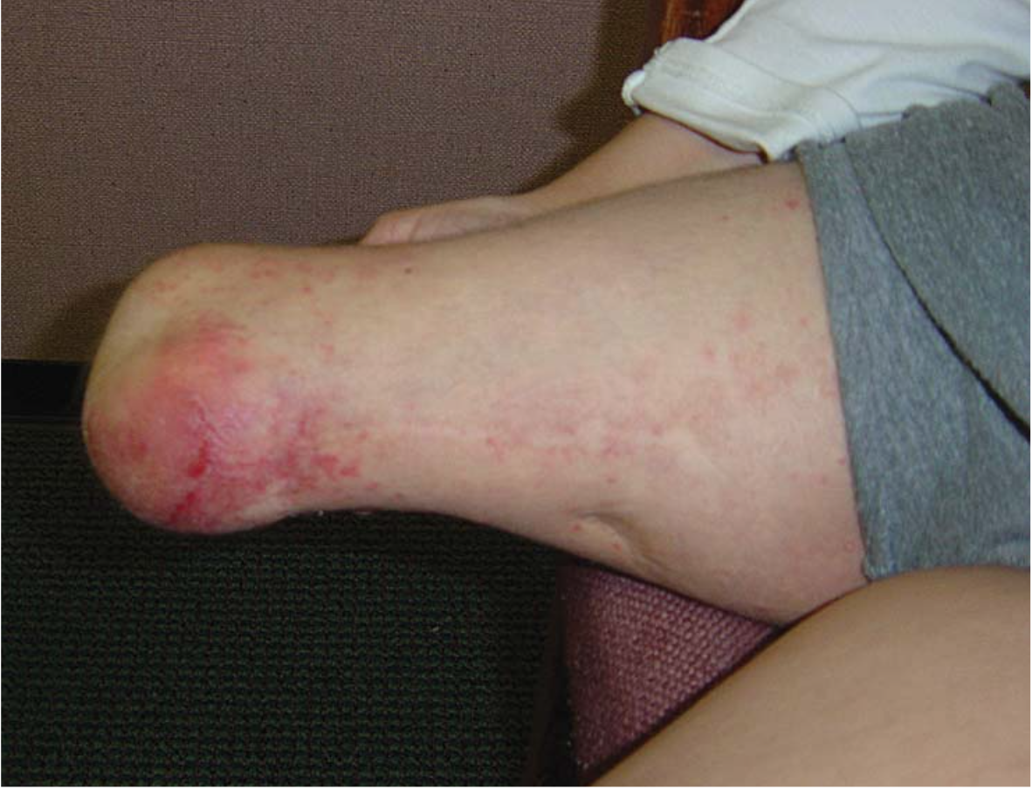
Project significance
1.6 million Americans with limb loss (2005)¹
Importance of Prostheses
Return to activities
Increased mobility
Many challenges with prosthetic use
Unnatural forces → injury²
Poor fit → prosthesis misuse²
Increased energy from user³
Acute erthyema and edema⁴

Slide 3
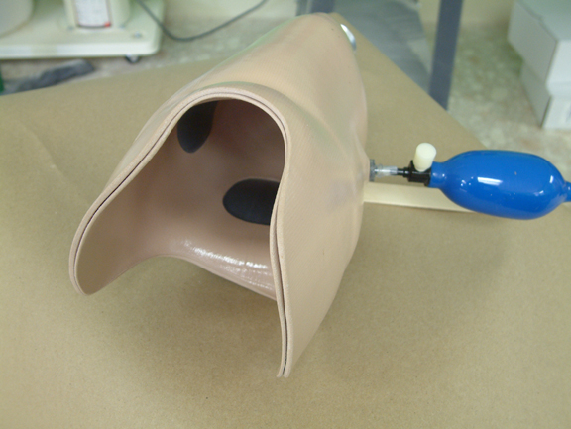
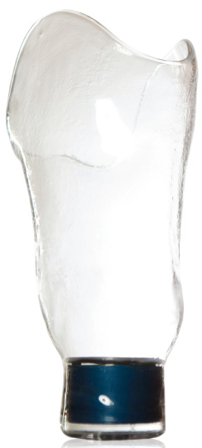
Current Prosthesis
Adjustable
Mechanical
Inflatable Inserts
Daily Fit
Vacuum
Suction
Static Fit
Compression Release Stabilized (CRS) Socket
Conventional Sockets
Socket with Pump [6]
SmartPuck [7]
Notes:
There are three main categories for current prosthesis. There are prothesis that are adjustable throughout the day, prosthesis for which the wearer sets the fit when they don the socket, and static fit prostheses.

Slide 4
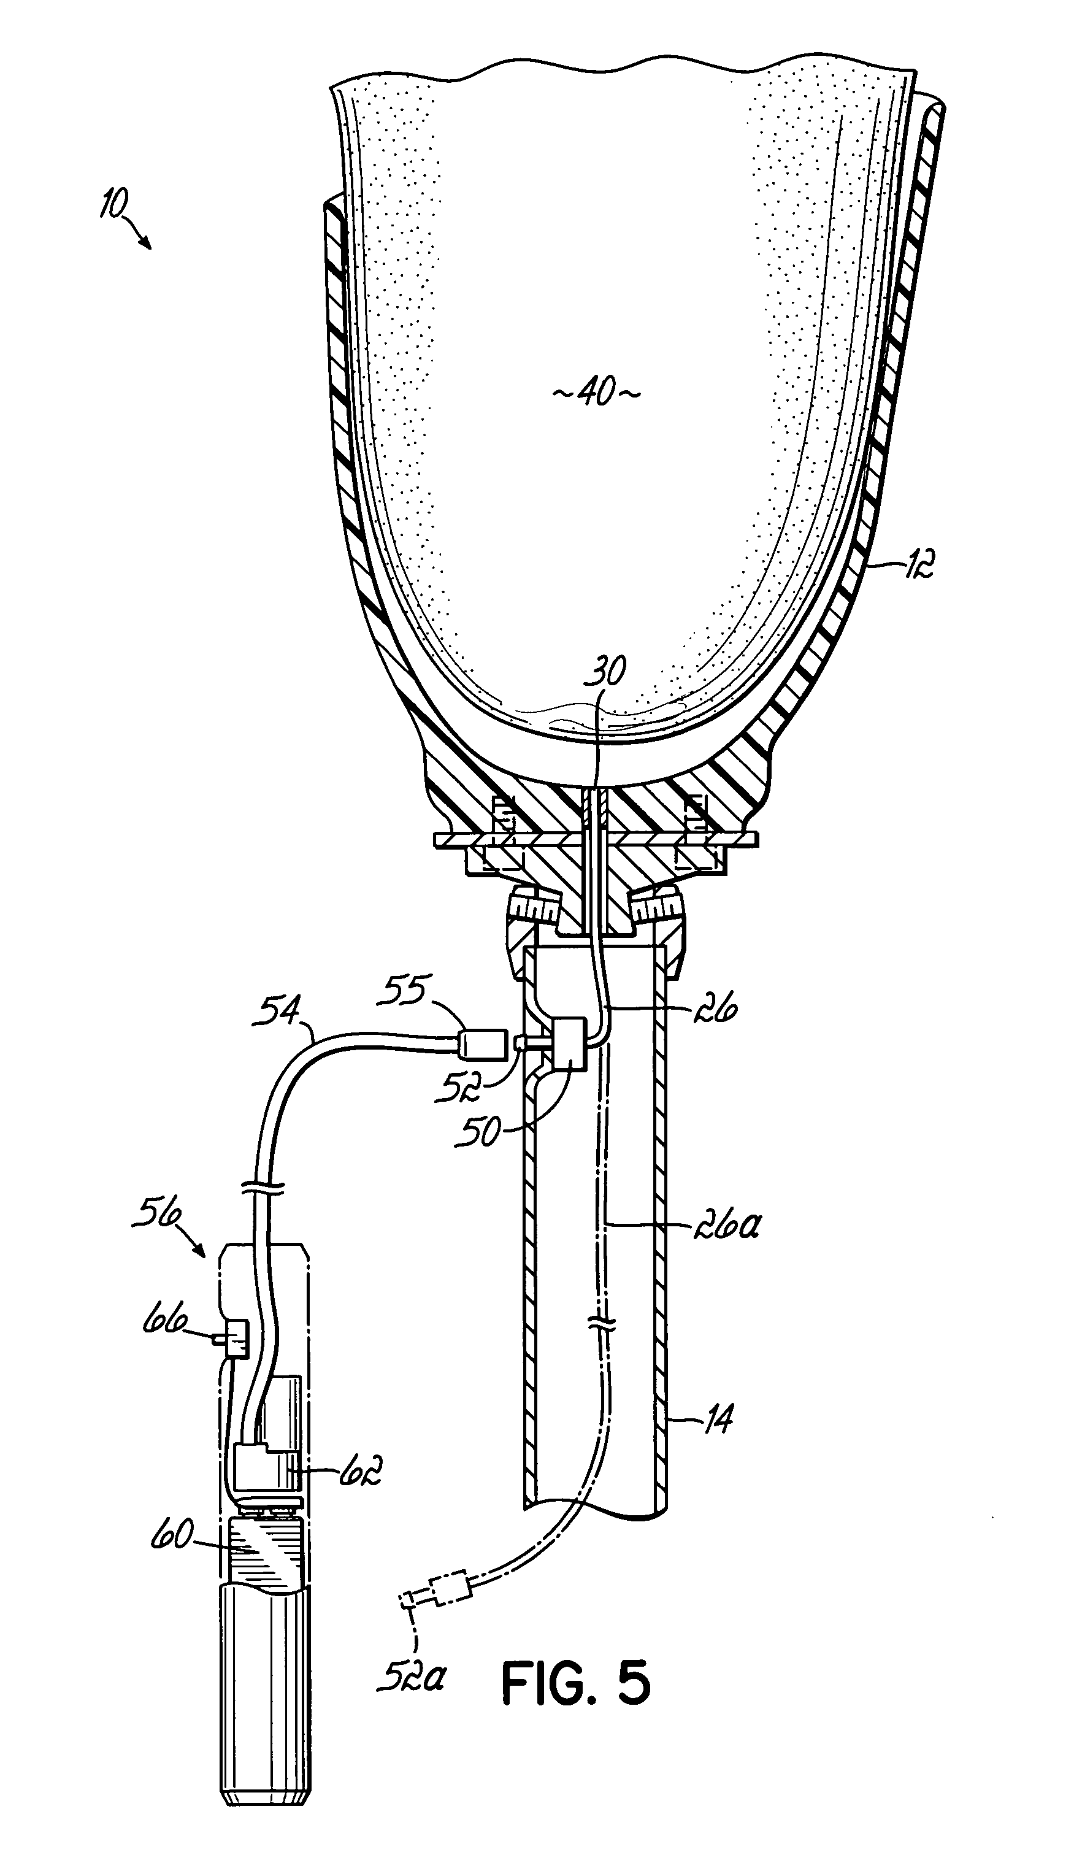
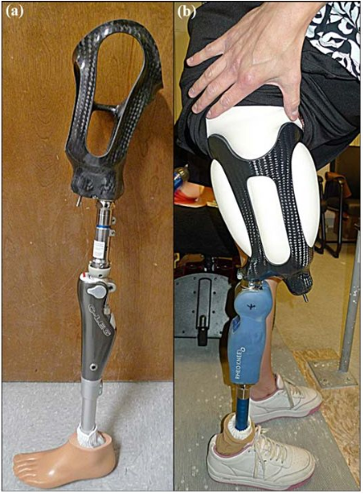

Purpose
Controllable smart variable geometry socket
Utilize compression/release stabilized (CRS) socket ideas⁹
Prosthetic Socket⁷
Adjust in fit⁸
Sense User Activity

Slide 5
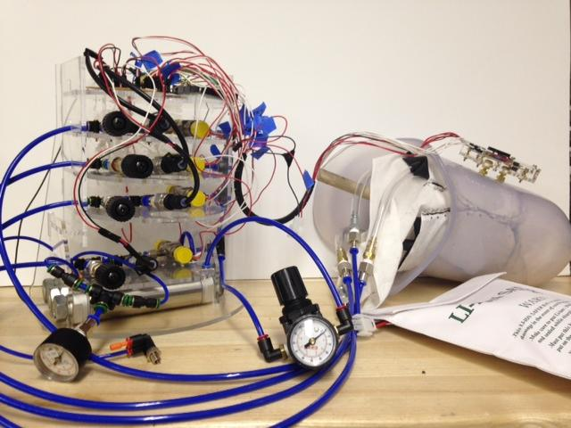
Improvements
Bladder system
Pneumatic vs. hydraulic
Custom electrical system
Advanced sensor systems
Lighter weight/increase portability
Safety Regulations
Previous MQP Project [10]

Slide 6
Project Objectives
Safe
Must not cause more harm than current socket technologies
Reliable
Must fail in predictable ways which shall not harm user
Comfortable
Be comparable in comfort to current technologies
Meet FDA device requirements¹¹
Minimal user-input
No need for adjustments throughout the day after initial donning
Long-lasting (daily use)
No need to recharge or adjust for minimum of average shopping trip length (58 minutes)¹²
Compact
Able to be mounted on the socket
Able to be worn under clothing
Lightweight
Within 25% of the current heaviest socket on market

Slide 7
Research Analysis

Slide 8
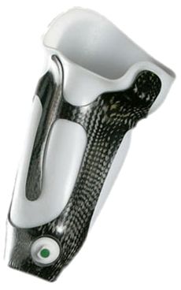
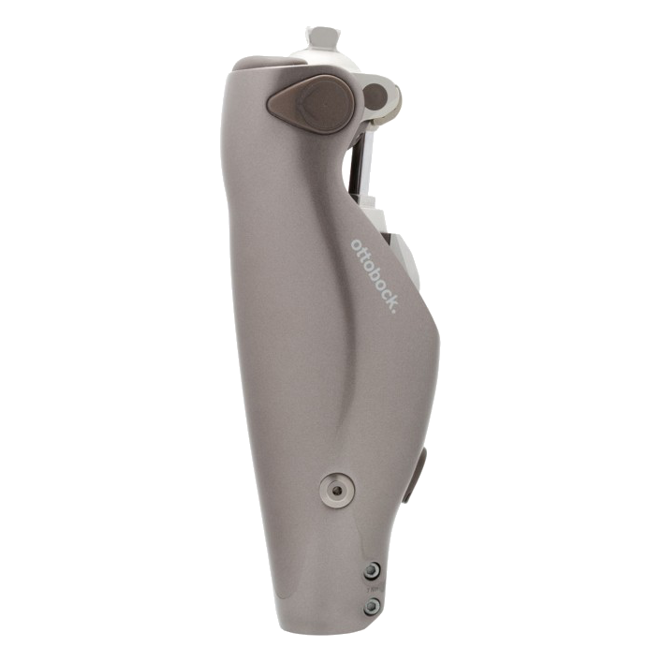
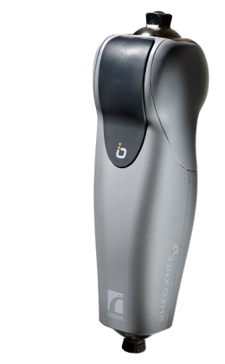
FDA/CDRH Certification
3 Categories
Based upon regulatory control required for safety
Detailed testing data recorded for future certification
Class I
External limb components
Socket components
Class II
Most hearing aids
C-leg microprocessor knee
Class III
Stair climbing wheelchair
Foot drop orthosis
Other limb braces
Powered wheelchair
[11]
[13]
[14]
[15]

Slide 9
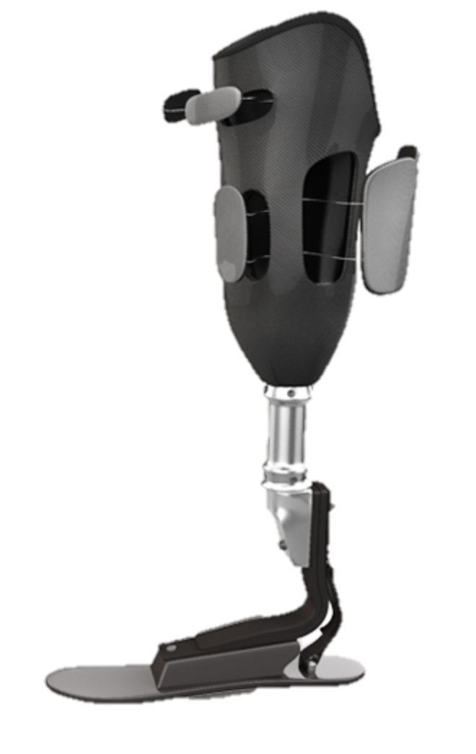
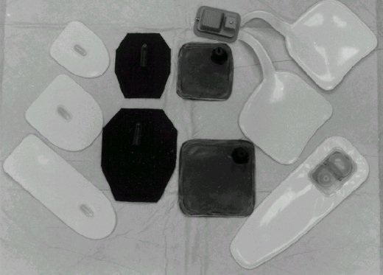
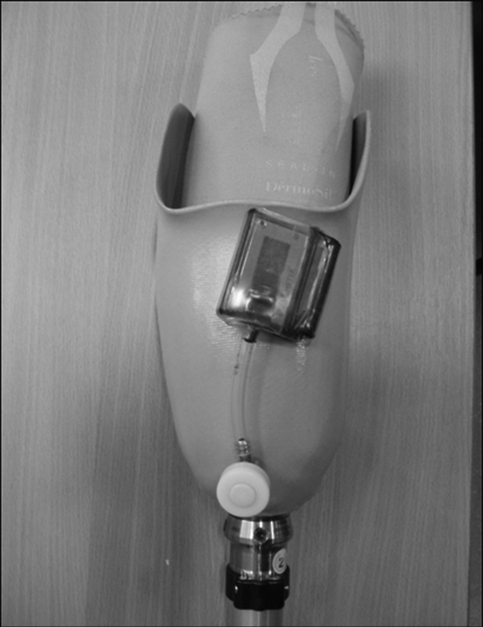
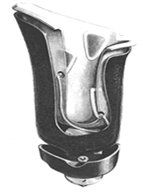
Types of Socket Solutions
Mechanically adjusting
Vacuum Suspension
Inflatable Inserts/Bladders
Compression Release Stabilized (CRS) Socket

Slide 10
Mechanically Adjusting
Examples:
LIM¹⁶
Revolimb¹⁷
Pros:
Fully adjustable
Cons:
Potential to over-tighten and occlude circulation
Notes:
Mechanically Adjusted sockets include the LIM and Revolimb. These sockets are fully adjustable through the use of ratcheting straps or tension dials to increase or decrease pressure and fit on the limb. This is beneficial, adding a longer useful lifespan to the limb itself, but requires constant adjustment from the user throughout the day and there is the possibility of overtightening the device, cutting off circulation in the limb.

Slide 11
Vacuum Suspension
Examples:
Vacuum Assisted Suspension System (VASS) ¹⁸
Pros:
Better adhesion to socket
Cons:
Possibility of soft tissue damage if donned incorrectly
Notes:
Vacuum suspension is another type of socket solution. It involves the user donning a liner, inserting their limb into the socket, and evacuating the air between the liner and socket. This creates a negative pressure on the limb and actually controls volume loss of the limb, providing better adhesion to the socket. The donning process is, however, much longer and can result in soft tissue damage if proper care is not taken and the socket is donned incorrectly.

Slide 12
Inflatable Air Inserts
Examples:
Pump it up! ¹⁹
Pneu-fit²⁰
Pros:
Easy to use and inflate
Cons:
Do not work over wide volume range
Notes:
Inflatable air bladders can be used as inserts in static sockets to help with volume control throughout the day. They’re pretty easy to use, only requiring that the user pump up the bladder to their desired pressure level. However, air is a compressible fluid and thus the bladders need to be pumped up to higher pressures and they don’t work over a wide volume range

Slide 13
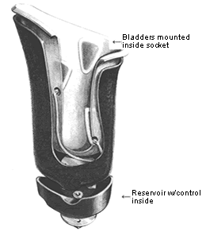
Inflatable Liquid Bladder
Example:
Smart Variable Geometry Socket²¹
Pros:
Wider volume management range
Cons:
Requires pumping or hydraulic system
Notes:
Inflatable liquid bladders are a much better option for volume control than air bladders. The incompressibility of liquids means that they have a much wider volume management range. They of course need some sort of pumping or hydraulic system to control the amount of fluid in the bladders. One example is the smart variable geometry socket, which utilizes the pumping cycle from walking and a control circuit to add fluid into the bladders. This design, however, does not allow individual control of the bladders and the user must be walking to maintain fluid in the bladders.

Slide 14
Compression Release Stabilized
Currently in development
Pros:
Better torque transfer from limb to socket
Cons:
Static system
Notes:
Inflatable liquid bladders are a much better option for volume control than air bladders. The incompressibility of liquids means that they have a much wider volume management range. They of course need some sort of pumping or hydraulic system to control the amount of fluid in the bladders. One example is the smart variable geometry socket, which utilizes the pumping cycle from walking and a control circuit to add fluid into the bladders. This design, however, does not allow individual control of the bladders and the user must be walking to maintain fluid in the bladders.

Slide 15
Dynamic Adjusting Prosthetic Socket (DAPS)
Our Project Approach
Research
Design Ideas
Outline of Design
Prototype/ Testing Design
Design Alterations
Final Testing & IRB
Testing

Slide 16
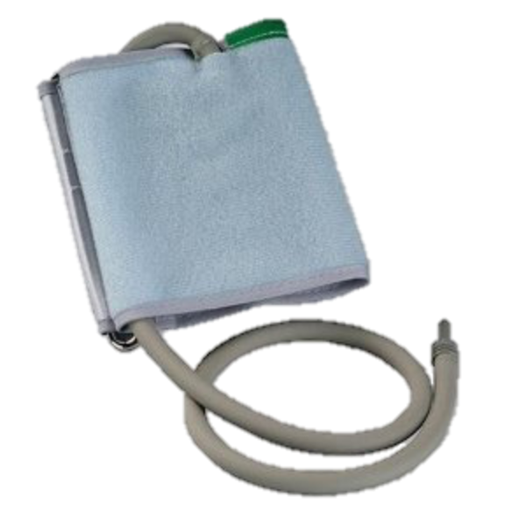
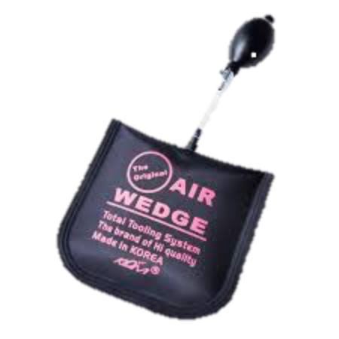
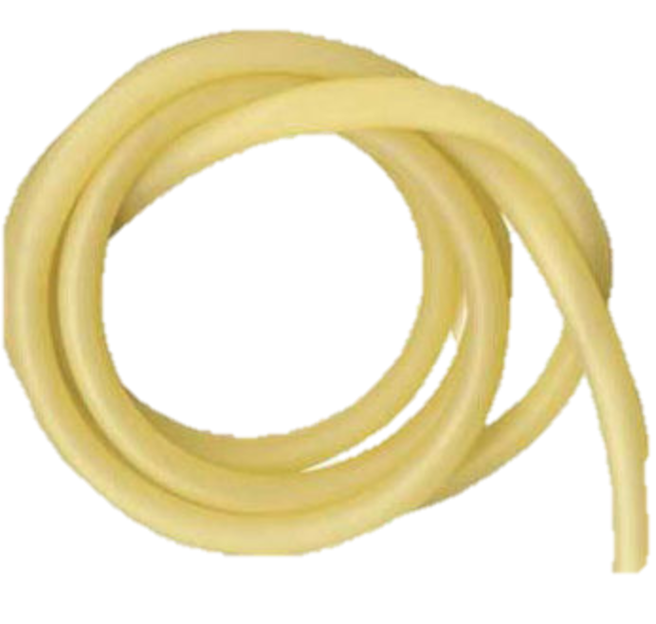
Bladder Types
Variation in shape²²⁻²⁴
Rectangular
Cuff
Cylindrical (tubing)
Custom
Materials
Silicon
Canvas
Kevlar
Neoprene
Polyurethanes
Nylon
Etc.

Slide 17
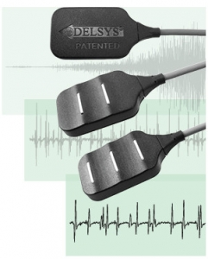
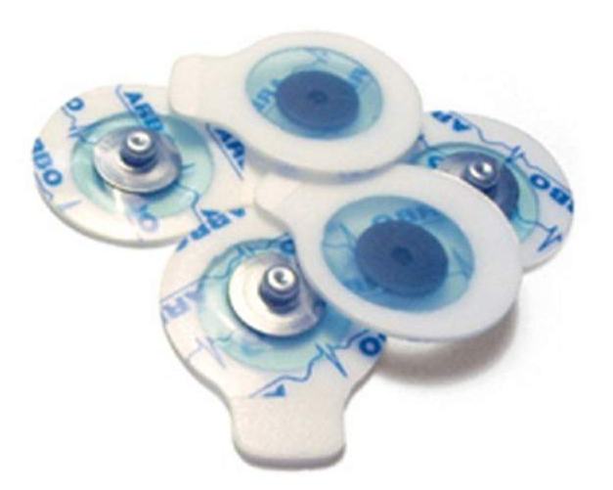
Electromyograms (EMG)
Research Tool²⁵
Upper limb prosthesis²⁶

Slide 18
Signal Noise
Electrode inherent noise²⁷
Movement artifact
Electromagnetic noise
Internal noise
Inherent noise

Slide 19
Noise Removal
Design techniques^{27,28}
Pre-amplifications
Electrical Filtering^{29,34}
Why we need it?
10-20Hz Min.
400-450Hz Max.

Slide 20
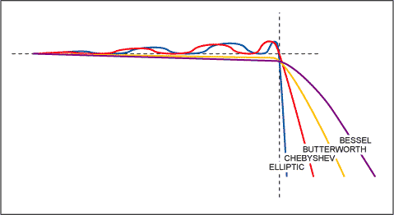
Noise Removal
Electrical filtering
Butterworth filter^{29.30}
Chebyshev filter³⁰
Elliptical filter³⁰
Bessel filter^{30,31}
[30]
Stop
Band
Pass Band

Slide 21
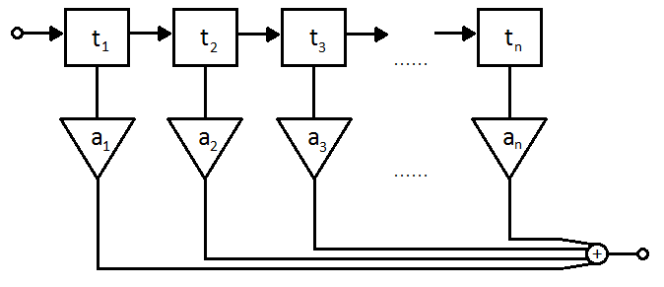
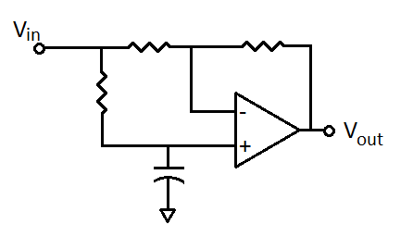
Noise Removal
Electrical filtering
Butterworth filter^{29.30}
Chebyshev filter³⁰
Elliptical filter³⁰
Bessel filter^{30,31}
Laguerre filter^{32,33}
All Pass
[34]
[35]

Slide 22
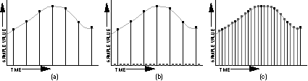
Noise Removal
Electrical filtering
Butterworth filter^{29.30}
Chebyshev filter³⁰
Elliptical filter³⁰
Bessel filter^{30,31}
Laguerre filter^{32,33}
All Pass
[34]
[36]

Slide 23
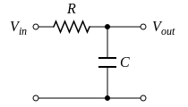
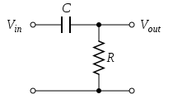
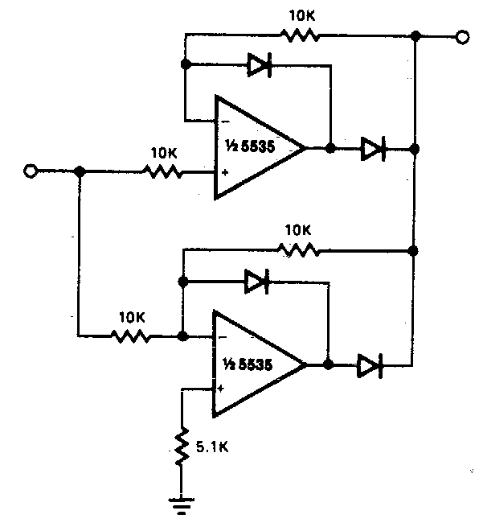
Noise Removal
Electrical filtering
Butterworth filter^{29.30}
Chebyshev filter³⁰
Elliptical filter³⁰
Bessel filter^{30,31}
Laguerre filter^{32,33}
All Pass
High/low pass³⁴
Rectifiers³⁴
[37]
[38]
[39]

Slide 24
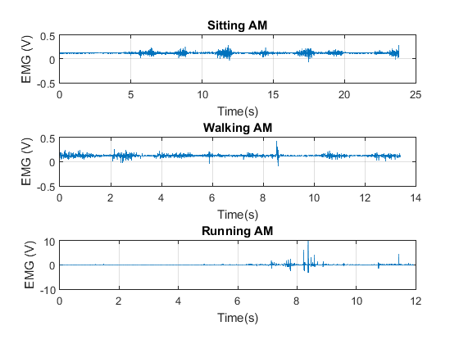
Signal Analysis
Intervals
Amplitude

Slide 25
Design review
Notes:
Based on the sockets from our research, work done on the previous project, and our own project goals, we decided on liquid bladder socket with a hydraulically actuated system.

Slide 26
Bladder Actuation Design
Why hydraulics?⁴²
Wider volume range than air
More precise fluid control
More independent control of bladder
Easier to implement than pump-reservoir system
Can create a “dynamic” CRS control
Notes:
Why hydraulics? As stated previously, liquid has a much wider volume management range than air. Hydraulics allow us independently control single bladders or pairs of bladders and provide more precise fluid control. We determined that a hydraulic system would be easier to implement than a pump-reservoir system which would require a series of switches, sensors, and a relatively powerful pump. Lastly, with our proposed hydraulic system, we could create a “dynamic” Compression Release Stabilized socket which can provide better torque transfer as well as managing limb volume and pressure put on the limb throughout the day.

Slide 27
Bladder Actuation Design
Considerations⁴³
Actuation of syringes
Type of fluid
Waterproofing electronics/leak prevention
Syringe/bladder volumes
Sensors
System weight
Notes:
For our hydraulic system, there are a long list of things we need to take into account when building and testing our design. Listed above are just a few including the actuation of the syringes – what force does our motor or linear actuator need to provide and how do we make it non-backdriveable. Type of fluid we’re using is also important, we will be using water for testing as it’s basically free and easy to clean up, but we will also see if there are benefits in using other types of liquids as well. Waterproofing the system and preventing leaks is also important to prevent destroying the electronics and making sure that the system maintains appropriate pressures on the users limb.
Bladder and syringe volumes must be large enough to account for maximum limb volume change throughout the day.
Sensors will be required to sense and control pressure.
And lastly, the end product has to be light enough for an amputee to actually use it, so choosing lightweight components is a very important part of the design as well.

Slide 28
Hydraulics Diagram
Pressure Sensor
Blow-off valve
Socket Wall
Linear actuator/motor
Syringe
Tubing
Bladder
Flex Sensor
^{[44]}
Notes:
Here is a diagram of our proposed hydraulic design for a single bladder. We plan on having between 4-6 total bladders in the system with the same exact setup. A linear actuator or motor drives the syringe piston back and forth, pushing the fluid through the tubing and into the bladder. A force from the limb will be applied to the bladder when it’s placed in the socket and pressure sensor inline with the tubing will detect changes in the system pressure due to the limb force. We also plan on putting a blow off or release valve for safety to make sure the maximum pressure in the system does not reach dangerous levels or cause components to burst. Additionally in the socket itself, we may place flex sensors to detect areas of excess pressure and provide feedback that can be used for analysis by a prosthetist in determining how well the socket has been working.

Slide 29
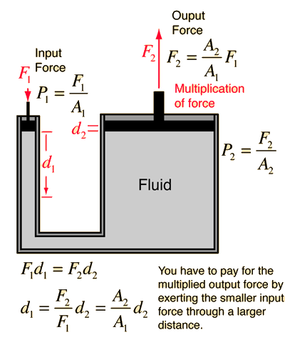
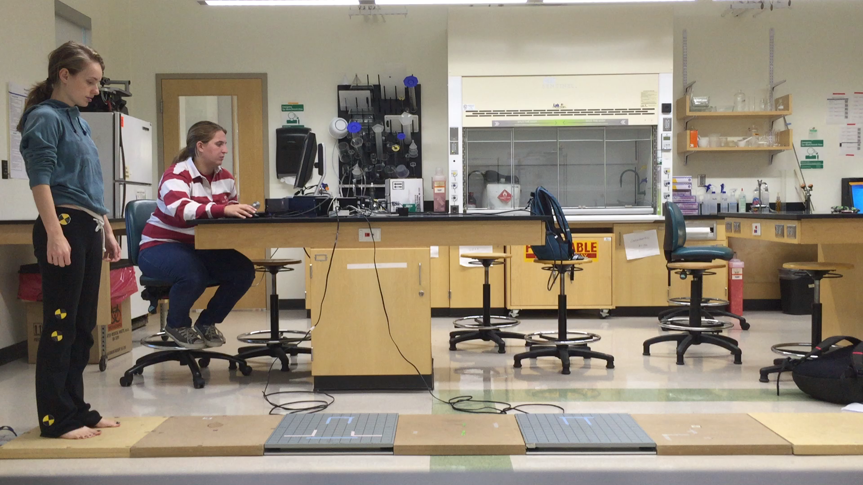
Hydraulics Calculations
Force Plate Testing
Motor criteria⁴⁴
Meet F₁ value: ~40.86N
Stroke length d₁: ~15.4cm
Adequate speed
Further testing
Syringe-bladder test rig
F_{Limb =} F₂
Syringe
Bladder
Notes:
In order to establish some basic requirements for the system, we did a few tests using force plates to determine the maximum possible force a bladder might experience. We took the max force from running, approximately 2000N and estimated values for the bladder surface area, syringe piston length, and piston surface area. Using this and multiplying by a factor of safety of 2, we determined that our motor input force needs to be about 40N. Additionally, the motor must provide a stroke length of about 15cm or 6 inches to travel the full length of the syringe piston and ideally we will use the fasted linear actuator possible. Lastly, we need to do is set up an test-rig to make sure that out design concept is feasible.

Slide 30
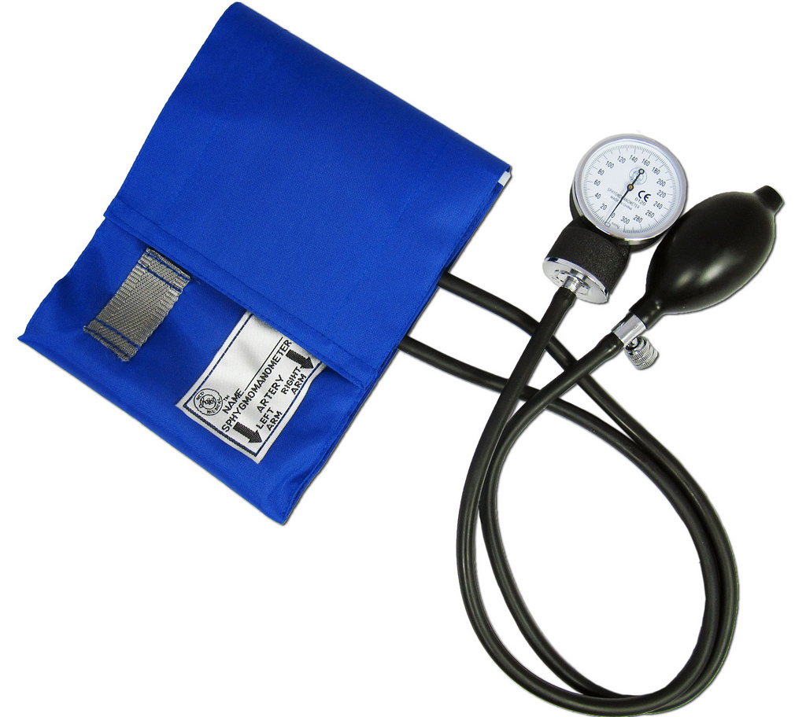
Bladders Prototypes
Blood pressure cuffs
Fabric
Silicone rubber mold
Surgical tubing
[46]
Notes:
For hydraulic bladders, we have 4 different prototype designs. The first design is the repurposing of a blood pressure cuff.

Slide 31
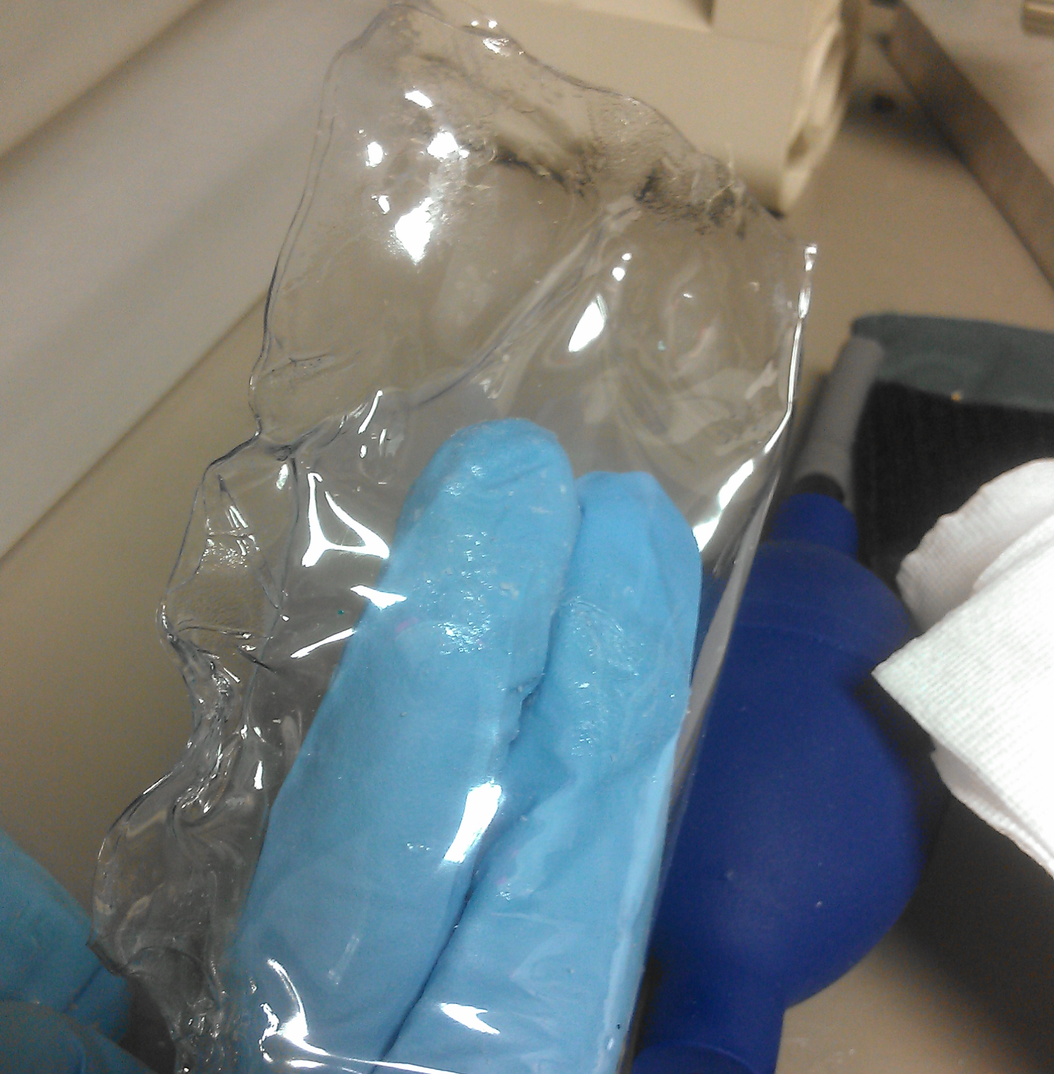
Bladders Prototypes
Blood pressure cuffs
Fabric
Silicone rubber mold
Surgical tubing
[47]
Notes:
The second design is based off of fabric; nylon and vinyl.

Slide 32
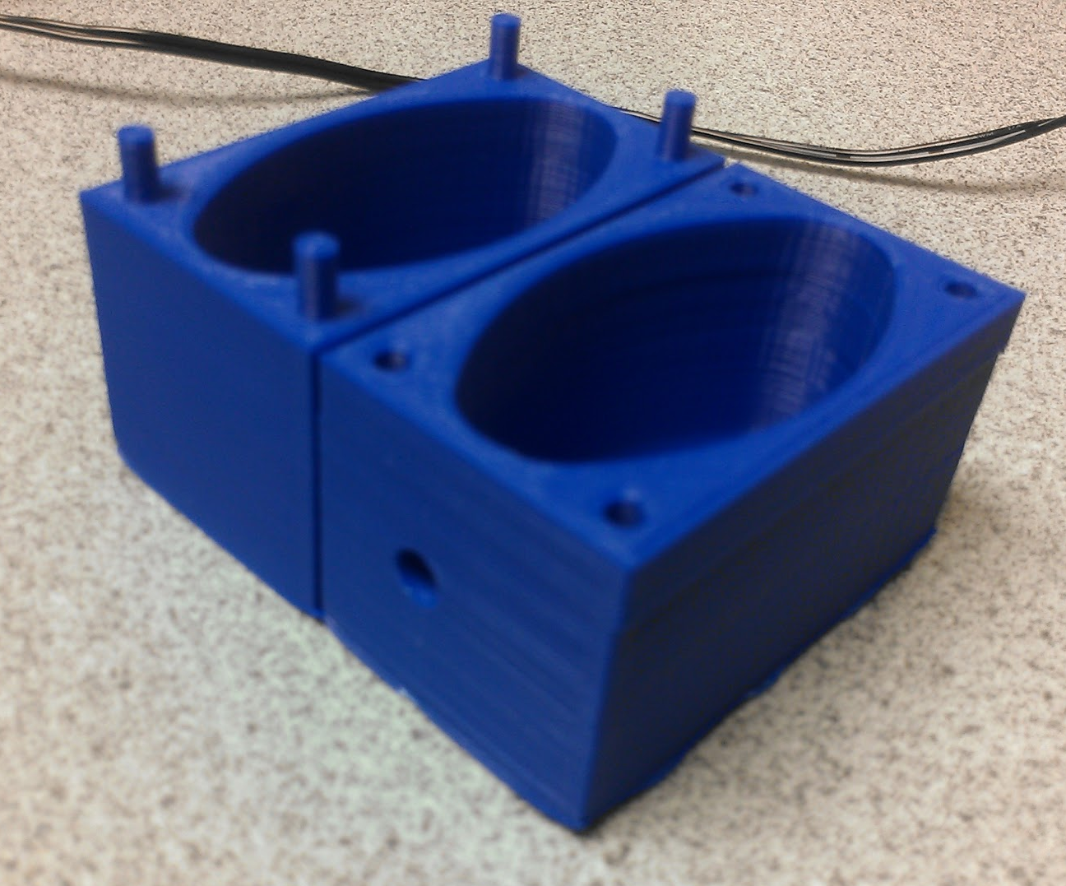
Bladders Prototypes
Blood pressure cuffs
Fabric
Silicone rubber mold
Surgical tubing
[48]
Notes:
The third is a mold from silicone rubber.

Slide 33
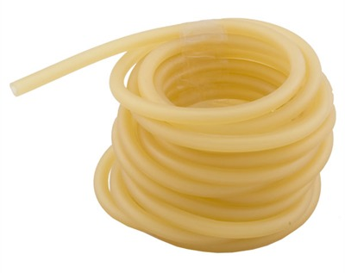
Bladders Prototypes
Blood pressure cuffs
Fabric
Silicone rubber mold
Surgical tubing
[49]
Notes:
The fourth is a bladder from the use of surgical tubing.

Slide 34
Design Matrix
Quality | Weight
Force (N) | 33%
Cost ($) | 12%
Durability | 12%
Effectiveness (x minutes) | 11%
Manufacturability | 10%
Customization | 10%
Weight (g) | 7%
Volume (mL) | 5%
Notes:
Here you can see the design matrix we’ll be using to score each bladder prototype.

Slide 35
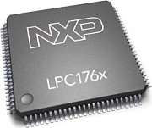
Sensing & Control
Motors
Front Left
Front Right
Signal Processing
Motor Drivers
sEMG Sensors
Back Left
Back Right
Pressor Sensors
ADC’s
User Controls (Buttons,
LED Display)
Voltage Regulators
Battery
[50]

Slide 36
Filtering Circuit
High and low pass filters
Full wave rectifiers
Low Pass Filter
High Pass Filter
[37-38]

Slide 37
Filtering Circuit
High and low pass filters
Full wave rectifiers
Full Wave Rectifier
[39]

Slide 38
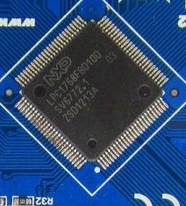
System Control
Microcontroller (NXP1764FBD100)
I/O Pins
32-bits
High clock speed
USART to USB
[51]
Notes:
http://www.ebay.com/itm/NXP-ARM-Cortex-M3-LPC1768-Mini-DK2-Development-board-/181045434143?hash=item2a2726171f

Slide 39
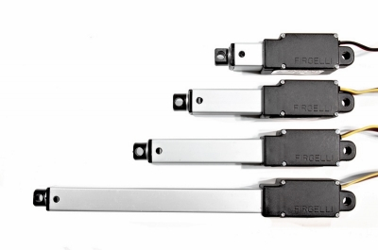
System Control
Motor Control
Drivers
Battery requirements
Voltage regulators
[52]
Notes:
http://www.firgelli.com/products.php?id=41

Slide 40
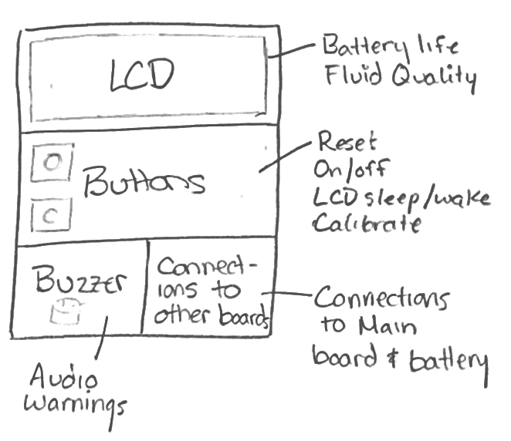
System Control
User Interface
Warnings – visual and audible
Reset
LCD
Sleep/wake
Battery life
On/off button
Load/unload
Debug/calibrate
[53]

Slide 41
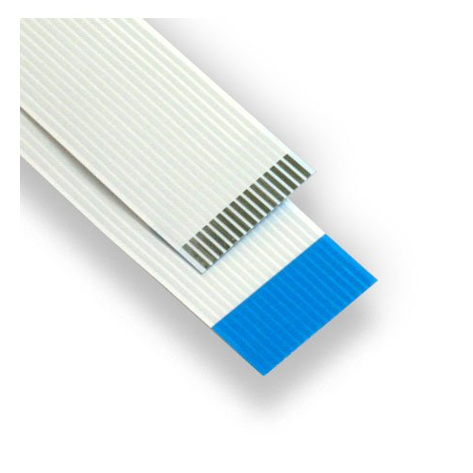
EMG Wiring
Flex wires with coating
Fitting sock with EMGs
[54]

Slide 42
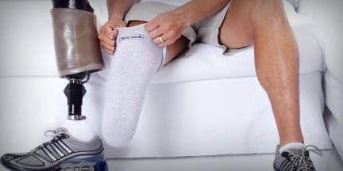
EMG Wiring
Flex wires with coating
Fitting sock with EMGs
[55]

Slide 43
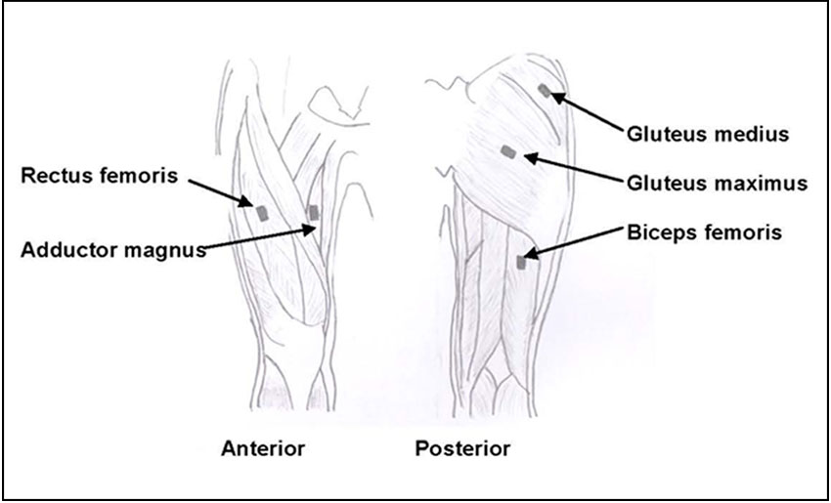
EMG Placement
Muscles to control leg extension/flexion
Abduction and adduction
Superficial muscles
[56]

Slide 44
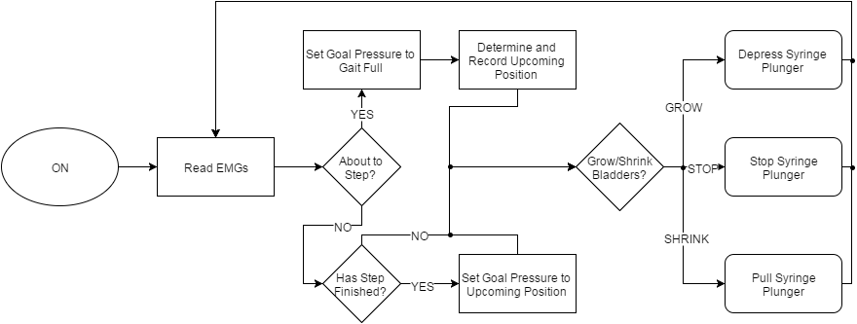
Control Algorithms
[57]
Notes:
This is the primary control algorithm. In short, the algorithm checks to see if the wearer is taking a step or moving to a new position. It then sets the goal pressure for the bladders and controls their position with PID.

Slide 45
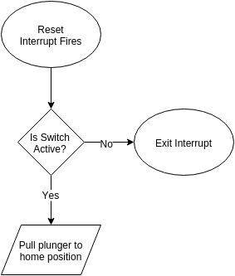
Control Algorithms
[58]
Notes:
This is the reset interrupt. When the reset switch is set, the interrupt will pull the syringes out to their home position. When the switch is turned off, the interrupt exits and the system returns to normal function.

Slide 46
Safety
Sensor information informs system to retract syringes
Bladders are too pressurized
Notes:
The following are three safety scenarios for which we are planning. The first is when the bladders are too pressurized. In this case the sensor information will inform the system to retract the syringes.

Slide 47
Safety
Sensor information informs system to retract syringes
Bladders are too pressurized
Bladders are too pressurized &
sensors have failed
User triggers the reset switch, syringes retract
Notes:
The second scenario is when the bladders are too pressurized and the sensors have failed. In this case the wearer can trigger the reset switch, depressurize the bladders, and remove their limb.

Slide 48
Safety
Sensor information informs system to retract syringes
Bladders are too pressurized
Bladders are too pressurized &
sensors have failed
User triggers the reset switch, syringes retract
Blow off valve releases pressure
Unforeseen emergency
Notes:
The final scenario is an unforeseen emergency. In this case, the blow off valve will release the pressure in the socket and allow the wearer to remove their limb.

Slide 49
Project Timeline

Slide 50
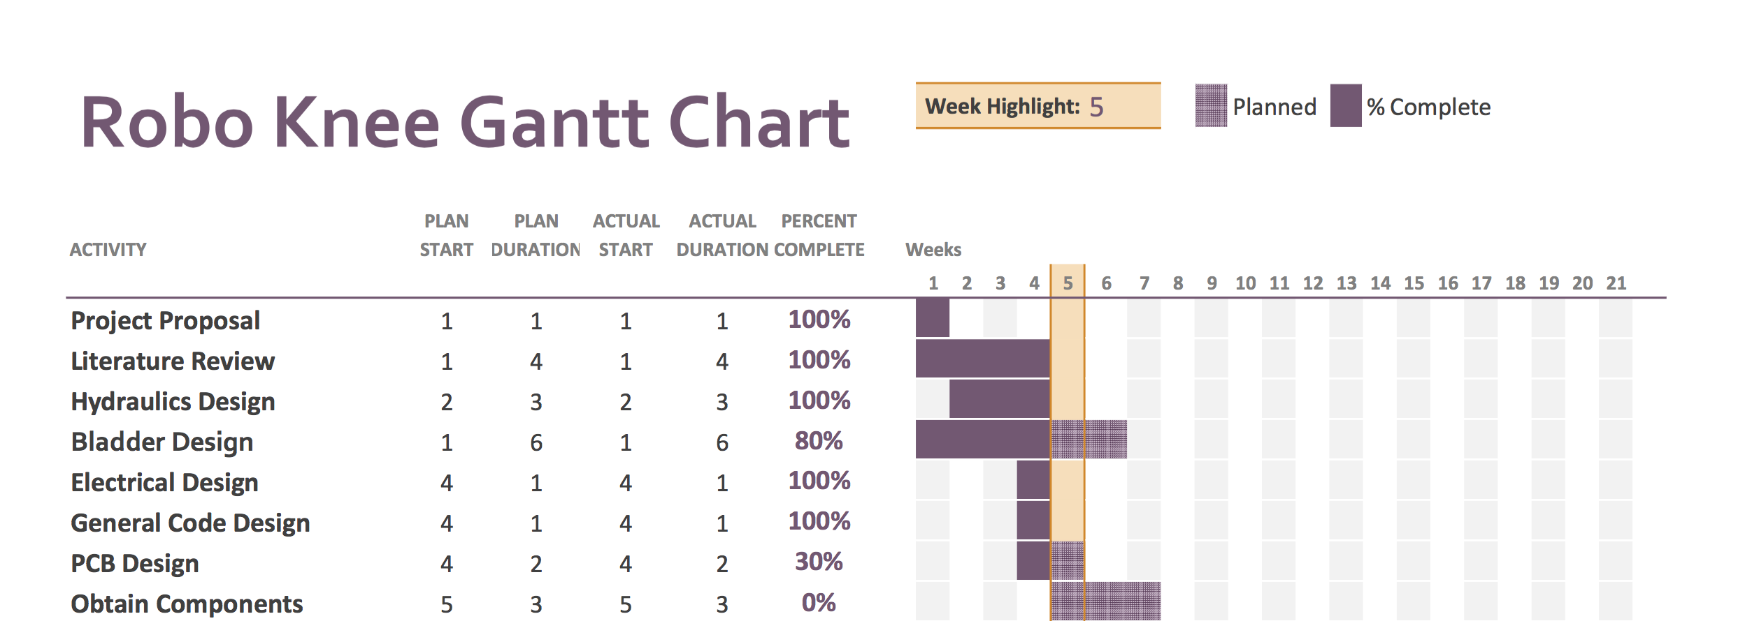
A-Term Schedule

Slide 51
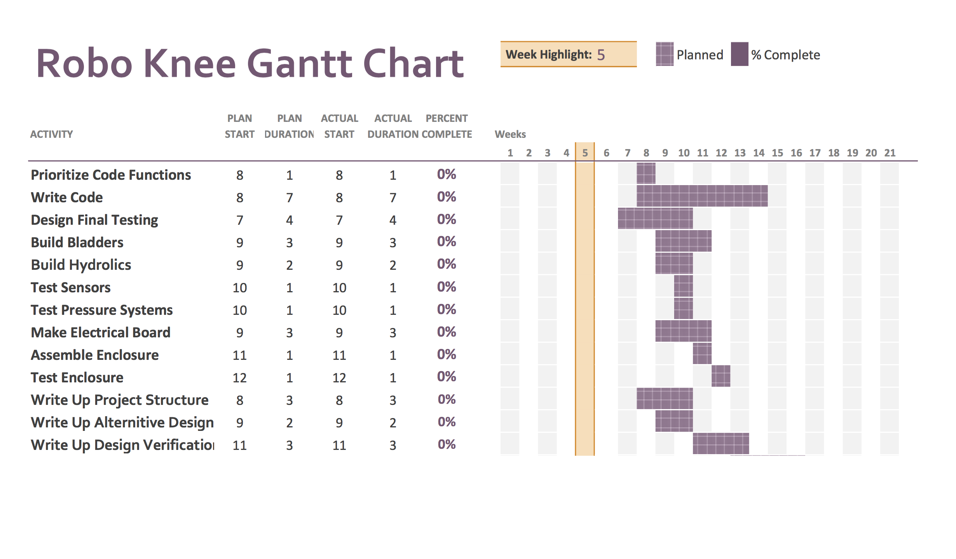
B-Term Schedule

Slide 52
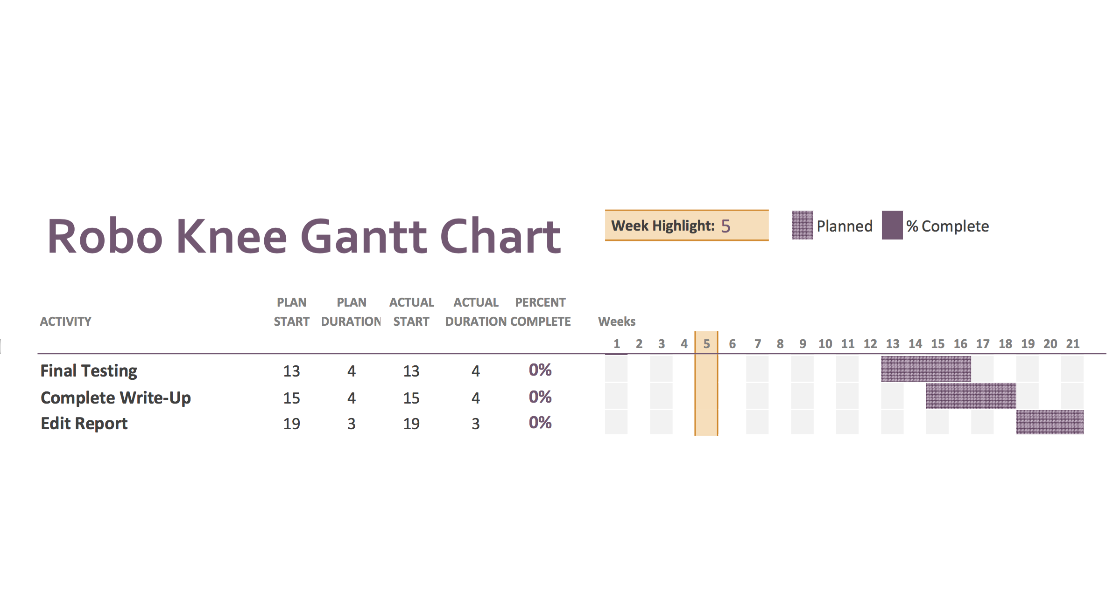
C- Term Schedule

Slide 53
Thank you!

Slide 54
Questions?

Slide 55
References
2. K. Ziegler-Graham, E. J. MacKenzie, P. L. Ephraim, T. G. Travison, and R. Brookmeyer, “Estimating the Prevalence of Limb Loss in the United States: 2005 to 2050,” Arch. Phys. Med. Rehabil., vol. 89, no. 3, pp. 422–429, Mar. 2008.
A. F. T. Mak, M. Zhang, and D. A. Boone, “State-of-the-art research in lower-limb prosthetic biomechanics- socket interface: A review,” J. Rehabil. Res. Dev., vol. 38, no. 2, pp. 161–174, Apr. 2001.
R. Alley, CP, LP, T. W. Williams, MA, M. J. Albuquerque, CPO, and D. E. Altobelli, MD, “Prosthetic sockets stabilized by alternating areas of tissue compression and release,” J. Rehabil. Dev., vol. 48, no. 6, pp. 679–696, Jun. 2011.
J. T. Highsmith and M. J. Highsmith, “Common skin pathology in LE prosthesis users,” JAAPA Off. J. Am. Acad. Physician Assist., vol. 20, no. 11, pp. 33–36, 47, Nov. 2007.
http://www.amputee-center.com/pump.htm
Smart Pump
R. Alley, CP, LP, T. W. Williams, MA, M. J. Albuquerque, CPO, and D. E. Altobelli, MD, “Prosthetic sockets stabilized by alternating areas of tissue compression W. A. Haines, J. M. Colvin, M. L. Haynes, C. T. Kelley, M. W. Ford, M. W. Groves, and J. A. Denune, “Prosthetic device utilizing electric vacuum pump,” US7947085 B2, 24-May-2011.
W. A. Haines, J. M. Colvin, M. L. Haynes, C. T. Kelley, M. W. Ford, M. W. Groves, and J. A. Denune, “Prosthetic device utilizing electric vacuum pump,” US7947085 B2, 24-May-2011. Previous MQP Project – Smart Socket 2014-15
U.S. Food and Drug Administration Regulation of Prosthetic Research, Development, and Testing
Kornum, N., & Bjerre, M. (n.d.). Grocery E-commerce: Consumer Behaviour and Business Strategies. Retrieved from https://books.google.com/books?id=cwEUj22Dlj8C&pg=PA82&lpg=PA82&dq=average+time+spent+in+grocery+store&source=web&ots=a9Yrom4v3x&sig=B4AOx9KoOWEtJKol9o6r61RS8Fs&hl=en&sa=X&oi=book_result&resnum=10&ct=result#v=onepage&q=average%20time%20spent%20in%20grocery%20store&f=false
COMFORTFLEX SOCKET SYSTEM
C-Leg 4
RHEO-KNEE
http://revolimb.com/
http://liminnovations.com/
http://www.aetna.com/cpb/medical/data/600_699/0630.html
http://www.amputee-center.com/pump.htm
http://www.oandp.com/shop/product.asp?supplier_id=B4AA5F60-C5E1-4DD5-A25F-E81B96DFB789&product_id=7C850D5A-894C-452B-94B0-94A7513D8F2C&department_id=0EA0CF9B-EB15-4377-8B60-ADA00B0FFBDD
http://www.oandp.org/jpo/library/2003_03_107.asp
http://www.bloodpressureatwatch.com/wp-content/uploads/2014/11/Omron-H-003DS-Small-Adult-Blood-Pressure-Cuff-for-IntelliSense-Monitors-0.jpg
http://uobds.com/Locksmith-Tools/
http://2kdk833xvsai3k7qcq368ael.wpengine.netdna-cdn.com/wp-content/uploads/2013/01/Surgical_Tubing_4c7e6cd42f4a3.jpg
EMG’s as a Research tool
EMG in upper limb prostetichs
EMG Noise
Design tech
Butterworth Filter Design. (n.d.). Retrieved from http://www.electronics-tutorials.ws/filter/filter_8.html
Filter Basics: Anti-Aliasing. (n.d.). Retrieved from https://www.maximintegrated.com/en/app-notes/index.mvp/id/928
Wazir, L., Mohammad, B., Muhammad, M., & Syed, S. (2014). Performance Analysis of Analog Butterworth Low Pass Filter as Compared to Chebyshev Type-I Filter, Chebyshev Type-II Filter and Elliptical Filter. Circuits and Systems, 5, 209–216. http://doi.org/http://dx.doi.org/10.4236/cs.2014.59023
Masnadi-Shirazi, M. A., & Aleshams, M. (2003). Laguerre discrete-time filter design. Computers & Electrical Engineers, 29(1), 173–192.
Manosube, A., Koseeyaporn, J., & Wardkein, P. (2014). PLI Cancellation in ECG Signal Based on Adaptive Filter by Using Wiener-Hopf Equation for Providing Initial Condition. Computational and Mathematical Methods in Medicine, 2014, 11. http://doi.org/http://dx.doi.org/10.1155/2014/471409
Transversal Filter drawn by Meagan H.
All-Pass Filter drawn by Meagan H.
Transversal Filter Response, http://www.tc.umn.edu/~erick205/Papers/paper.html
Hihg-Pass Filters, Low-Pass Filters, 2015 http://www.allaboutcircuits.com/textbook/alternating-current/chpt-8/high-pass-filters/
Filter Compare
Transversal Filter
All Pass Filter
Transversal Response
Josh
Josh
Josh
Josh
https://www.flickr.com/photos/107621760@N03/10668630046
Photo Taken by Jake Z. of Vinyl Fabric
Photo taken by Jake Z. of plastic mold
SURGICAL TUBING | Brownells
Outline of Circuit drawn by Meagan H. Photo of NXP LCP176x from http://www.nxp.com/
http://www.ebay.com/itm/NXP-ARM-Cortex-M3-LPC1768-Mini-DK2-Development-board-/181045434143?hash=item2a2726171f
http://www.firgelli.com/products.php?id=41
User Interface outline Drawn by Meagan H.
Flex Wires, http://en.esskabel.de/ffc-fdc/C21/
Prosthetic Sock, http://www.knitrite.com/about.html
Mollie
Main Control Diagram drawn by Jake Z.
Control Interrupt Diagram drawn by Jake Z.

Slide 56
References
2. K. Ziegler-Graham, E. J. MacKenzie, P. L. Ephraim, T. G. Travison, and R. Brookmeyer, “Estimating the Prevalence of Limb Loss in the United States: 2005 to 2050,” Arch. Phys. Med. Rehabil., vol. 89, no. 3, pp. 422–429, Mar. 2008.
A. F. T. Mak, M. Zhang, and D. A. Boone, “State-of-the-art research in lower-limb prosthetic biomechanics- socket interface: A review,” J. Rehabil. Res. Dev., vol. 38, no. 2, pp. 161–174, Apr. 2001.
R. Alley, CP, LP, T. W. Williams, MA, M. J. Albuquerque, CPO, and D. E. Altobelli, MD, “Prosthetic sockets stabilized by alternating areas of tissue compression and release,” J. Rehabil. Dev., vol. 48, no. 6, pp. 679–696, Jun. 2011.
J. T. Highsmith and M. J. Highsmith, “Common skin pathology in LE prosthesis users,” JAAPA Off. J. Am. Acad. Physician Assist., vol. 20, no. 11, pp. 33–36, 47, Nov. 2007.
http://www.amputee-center.com/pump.htm
Smart Pump
J. T. Highsmith and M. J. Highsmith, “Common skin pathology in LE prosthesis users,” JAAPA Off. J. Am. Acad. Physician Assist., vol. 20, no. 11, pp. 33–36, 47, Nov. 2007.
W. A. Haines, J. M. Colvin, M. L. Haynes, C. T. Kelley, M. W. Ford, M. W. Groves, and J. A. Denune, “Prosthetic device utilizing electric vacuum pump,” US7947085 B2, 24-May-2011.
http://www.oandp.com/articles/2008-02_01.asp
Previous MQP Project – Smart Socket 2014-15
U.S. Food and Drug Administration Regulation of Prosthetic Research, Development, and Testing
Kornum, N., & Bjerre, M. (n.d.). Grocery E-commerce: Consumer Behaviour and Business Strategies. Retrieved from https://books.google.com/books?id=cwEUj22Dlj8C&pg=PA82&lpg=PA82&dq=average+time+spent+in+grocery+store&source=web&ots=a9Yrom4v3x&sig=B4AOx9KoOWEtJKol9o6r61RS8Fs&hl=en&sa=X&oi=book_result&resnum=10&ct=result#v=onepage&q=average%20time%20spent%20in%20grocery%20store&f=false
COMFORTFLEX SOCKET SYSTEM
C-Leg 4
RHEO-KNEE
http://revolimb.com/
http://liminnovations.com/
http://www.aetna.com/cpb/medical/data/600_699/0630.html
http://www.amputee-center.com/pump.htm
http://www.oandp.com/shop/product.asp?supplier_id=B4AA5F60-C5E1-4DD5-A25F-E81B96DFB789&product_id=7C850D5A-894C-452B-94B0-94A7513D8F2C&department_id=0EA0CF9B-EB15-4377-8B60-ADA00B0FFBDD
http://www.oandp.org/jpo/library/2003_03_107.asp
http://www.bloodpressureatwatch.com/wp-content/uploads/2014/11/Omron-H-003DS-Small-Adult-Blood-Pressure-Cuff-for-IntelliSense-Monitors-0.jpg
http://uobds.com/Locksmith-Tools/
http://2kdk833xvsai3k7qcq368ael.wpengine.netdna-cdn.com/wp-content/uploads/2013/01/Surgical_Tubing_4c7e6cd42f4a3.jpg
EMG’s as a Research tool
EMG in upper limb prostetichs
EMG Noise
Design tech
Butterworth Filter Design. (n.d.). Retrieved from http://www.electronics-tutorials.ws/filter/filter_8.html
Filter Basics: Anti-Aliasing. (n.d.). Retrieved from https://www.maximintegrated.com/en/app-notes/index.mvp/id/928
Wazir, L., Mohammad, B., Muhammad, M., & Syed, S. (2014). Performance Analysis of Analog Butterworth Low Pass Filter as Compared to Chebyshev Type-I Filter, Chebyshev Type-II Filter and Elliptical Filter. Circuits and Systems, 5, 209–216. http://doi.org/http://dx.doi.org/10.4236/cs.2014.59023
Masnadi-Shirazi, M. A., & Aleshams, M. (2003). Laguerre discrete-time filter design. Computers & Electrical Engineers, 29(1), 173–192.
Manosube, A., Koseeyaporn, J., & Wardkein, P. (2014). PLI Cancellation in ECG Signal Based on Adaptive Filter by Using Wiener-Hopf Equation for Providing Initial Condition. Computational and Mathematical Methods in Medicine, 2014, 11. http://doi.org/http://dx.doi.org/10.1155/2014/471409
Transversal Filter drawn by Meagan H.
All-Pass Filter drawn by Meagan H.
Transversal Filter Response, http://www.tc.umn.edu/~erick205/Papers/paper.html
Hihg-Pass Filters, Low-Pass Filters, 2015 http://www.allaboutcircuits.com/textbook/alternating-current/chpt-8/high-pass-filters/
Filter Compare
Transversal Filter drawn by Meagan H.
All Pass Filter Filter drawn by Meagan H.
Transversal Response
http://www.oandp.org/jpo/library/2003_03_107.aspConsiderations Outlined by Josh, Jake and Meagan
Hydraulics System Outline drawn by Josh F.
https://www.physicsforums.com/threads/pressure-diameter-and-flow-in-a-pneumatic-system.742188/ Photo Taken by Jake Z. of Vinyl Fabric
Filter drawn by Meagan H.
Photo taken by Jake Z. of plastic mold
SURGICAL TUBING | Brownells
Outline of Circuit drawn by Meagan H. Photo of NXP LCP176x from http://www.nxp.com/
http://www.ebay.com/itm/NXP-ARM-Cortex-M3-LPC1768-Mini-DK2-Development-board-/181045434143?hash=item2a2726171f
http://www.firgelli.com/products.php?id=41
User Interface outline Drawn by Meagan H.
Flex Wires, http://en.esskabel.de/ffc-fdc/C21/
Prosthetic Sock, http://www.knitrite.com/about.html
http://www.rehab.research.va.gov/jour/2013/504/images/pantall504f01lb.jpg
Main Control Diagram drawn by Jake Z.
Control Interrupt Diagram drawn by Jake Z.

